Slide 1
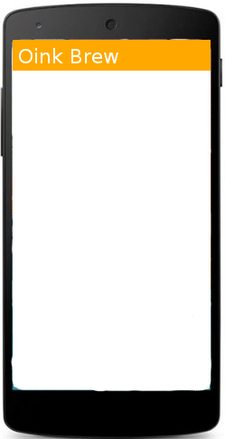
Step 1: Close all Valves
Close all valves from each pot and pumps
NEXT: change screen
Step 1
Close all valves on each kettle and each pump
Next

Slide 2
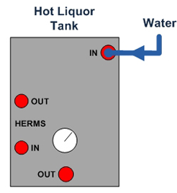
Step 2: Fill HLT with water
Fill HLT with required water from recipe
NEXT: change screen
Step 2
Fill HLT with required amount of water from your recipe
Next

Slide 3
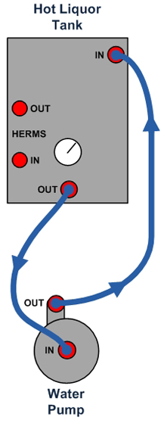
Step 3: Connect HLT with Pump 1
Confirm connected
NEXT: Turn on Pump 1
Step 3
Connect hoses to HLT and Pump 1
Confirm
Next

Slide 4
Step 4: Heat Strike Water
Set strike temperature
APPLY: send target temp to controller
Show figure that shows target strike temperature and current HLT water temperature
When temperature reached raise an alarm and activate NEXT
NEXT: turn off Pump 1, turn off heat HLT heat element
Step 4
Strike Temperature
69 C
Apply
HLT Out Temperature
43 C
Next
Next

Slide 5
Step 5: Change hose connection
Close all valves
Connect hose from HLT in to Mash In
Open valves
Confirm change
NEXT: turn on Pump 1

Slide 6
Step 6: Transfer strike water to Mash tun
Confirm when Mash tun reached wanted water level
Button to stop Pump 1
Make NEXT active once button was pressed
NEXT: Change screen

Slide 7
Step 7: Connect hose for Mash
Close all valves
Connect Pump 1 out to HLT in
Connect Pump 1 in to HLT out
Connect Pump 2 out to HLT Herms in
Connect Pump 2 in to Mash out
Connect HLT Herms out to Mash in
Open the valves
Next: Turn on Pump 1, Pump 2 and HLT heat element

Slide 8
Step 8: Heat strike water in Mash tun
Show figure that shows current Mash tun temperature, current HLT temperature and target strike temperature
Raise alarm once temperature reached
NEXT: turn off Pump 2

Slide 9
Step 9: Mash In
Mash in malt
NEXT: Turn on Pump 2

Slide 10
Step 10: Mashing
Show Mash In temperature, Mash Out temperature, HLT temperature
Field to set HLT temperature
Field to set timer
Button to start step
Raise alarm when timer is 0
NEXT: change screen

Slide 11
Step 11: Mash Out
Show Mash In temperature, Mash Out temperature, HLT temperature
Set target temperature to 76 C
Raise alarm once temperature reached
NEXT: turn off Pump 1, turn off Pump 2, turn HLT heat element

Slide 12
Step 12: Connect hose for sparging
Close all valves
Connect HLT out to Pump 1 In
Connect Pump 1 out to HLT Herms In
Connect HLT Herms Out to Mash In
Connect Mash Out to Pump 2 In
Connect Pump 2 Out to Boil In
Open Mash Out valve slightly
Open HLT Out valve so that Mash liquid level stays the same
NEXT: turn on Pump 1, turn on Pump 2

Slide 13
Step 13: Finish sparging
Show button to mark that sparging is finished
Once button pressed turn off Pump 1 and Pump 2
NEXT: turn on Pump 1, turn on Pump 2

Slide 14
Step 14: Prepare Boil
Close all valves
Fill HLT with water
Connect Mash Out to Pump 2 In
Connect Pump 2 Out to sink
NEXT: Turn on Boil element 100%, turn on Pump 2

Slide 15
Step 15: Boil
Show Timer Field to set boil time
Show PWM field to set heat intensity
Show button to mark Boil start, this with start count down Boil time
Once biol starts it will be replace by APPLY to set new PWM value
Show 2 button for Pump 1 and Pump 2 to toggle on/off
Raise alarm when boil time is 0 and turn off Boil heat element
NEXT: Change screen

Slide 16
Step 16: Prepare chill
Close all valves
Connect Boil Out with Pump 2 In
Connect Pump 2 Out with HLT Herms In
Connect HLT Herms Out with Boil In
Open Boil out valve slowly
NEXT: Turn on Pump 2

Slide 17
Step 17: Chill
Show field to set target temperature
Show Boil Out temperature
Raise alarm when target temperature reached
NEXT: Turn off Pump 2

Slide 18
Step 17: Fill fermenter
Close all valves
Stir to create whirl pool
Wait for 15 minutes
Connect Boil Out with hose for fermenter
Open Boil valve slightly
BREW FINISHED

